Slide 1

Workshop on phenotyping standards General Overview
Anne-Françoise Adam-Blondon
& Célia Michotey
29-30 April - Lund

Slide 2
Context

Slide 3
Modeling the impact of climate change using plant phenology
Global plant phenology data portal: www.plantphenology.org
Pan European PEP725 Plant phenology database: http://www.pep725.eu/
Phenology data
Climatic data
Date associated to:
Geo-reference
species
event (e.g. 50% of opened flowers)
Date associated to:
Geo-reference
Measures (e.g T°C, …)
Events (e.g. hail, …)
Interoperability
Phenology data : different sources => possibly different ways to describe, record and format data
Modelers of the impact of climate change
Geneticists, breeders
Genbank managers
Experimental station managers
Civil (economic) society: e.g. vintage dates, cherry blooming date…

Slide 4
Predictive biology: Genomic x Environment x Phenomic
Interoperability of heterogeneous data sets

Slide 5
Data is scattered in an “ecosystem” of information systems
International
repositories
Grapevine community’s repositories
Data production
Infrastructures for genomic data production
GeneBank & EMBL archives
Gramene
ORCAE
VitisCyc
Communitity standards
Standardized data, identifiers
Grapevine
Germplasm Repositories
GLIS/DOI
BioSample
VVIC
VitisDB
GRIN
Data + metadata
Curated data
Agroportal
Biosharing
GnpIS
Crop Ontology
Identifiers, reference data
Infrastructures for plant phenotyping
Data integration, knowledge development
Individual data producers
KnetMiner
InterPRO…
From Adam-Blondon et al (2016) HortRes, 3:16056

Slide 6
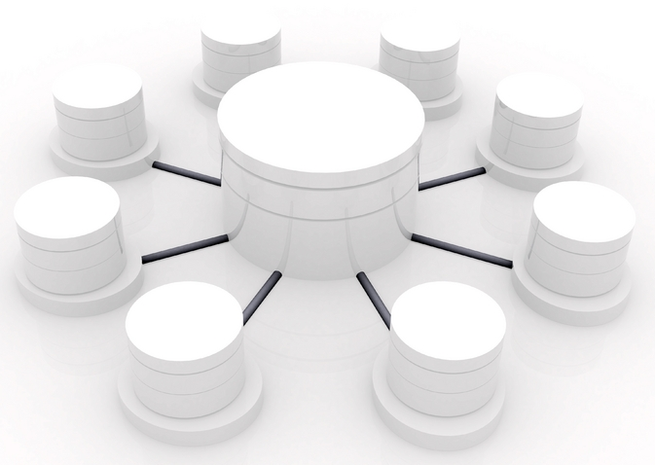
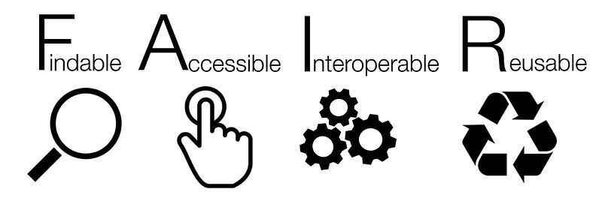
Featuring federations of information systems
A network of (stable/sustainable) nodes
A central portal offering services (e.g. search data)
Backbone of good practices enabling such infrastructures
Nodes → Resources
Hub→ Portal
Services access
Wilkinson et al (2016) SCIENTIFIC DATA, 3:160018, DOI: 10.1038/sdata.2016.18

Slide 7
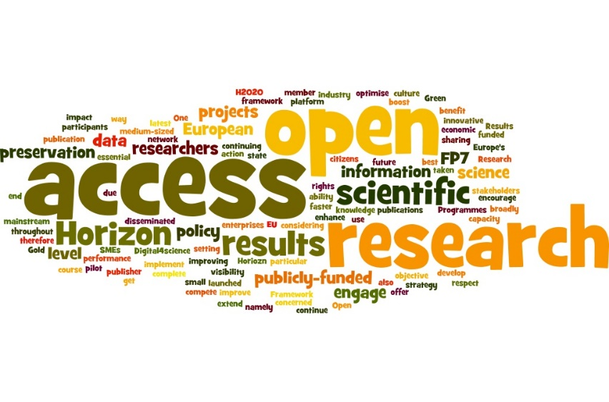

Europe is continuously reinforcing its policy for facilitating open access and interoperability
“Facilitating access to results encourages the re-use of research outputs and supports Open Science. This is essential for Europe's ability to enhance its economic performance and improve the capacity to compete through knowledge. […] Results of publicly-funded research can therefore be disseminated more broadly and faster, to the benefit of researchers, innovative industry and citizens.
Recently funded projects were asked to add a WP supporting a FAIR compliant Data Management Plan

Slide 8
This policy is implemented via the European Open Science Cloud (EOSC)
The European infrastructures in Life Science should contribute to EOSC
E.g. European Infrastructure of Bioinformatics for Life-sciences, ELIXIR (23 countries)
From N. Blomberg

Slide 9
ELIXIR’s objectives
Marine metagenomics
Human data
Plants
Metabolomics
Proteomics
Galaxy
Rare diseases
Contacts Plants: Celia Miguel (IBET) & Cyril Pommier (INRA)
From N. Blomberg

Slide 10
Open data, FAIR data

Slide 11
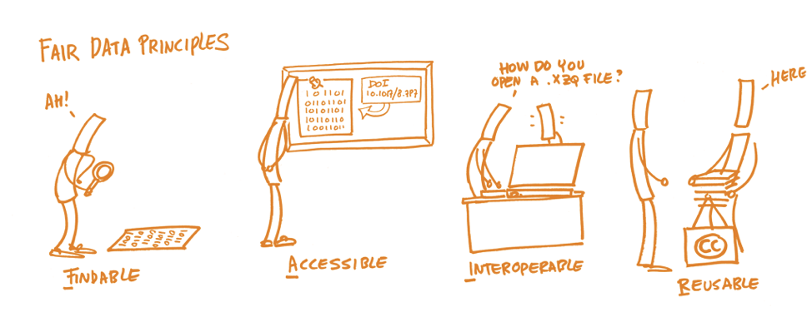
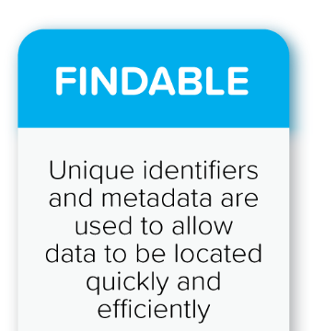
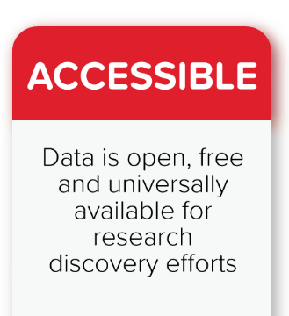
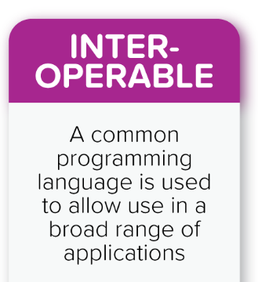
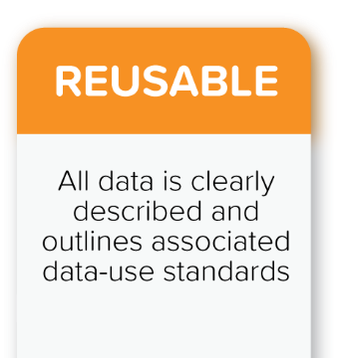
FAIR Data Principles
Wilkinson et al., The FAIR Guiding Principles for scientific data management and stewardship. Scientific Data 3 (2016)

Slide 12
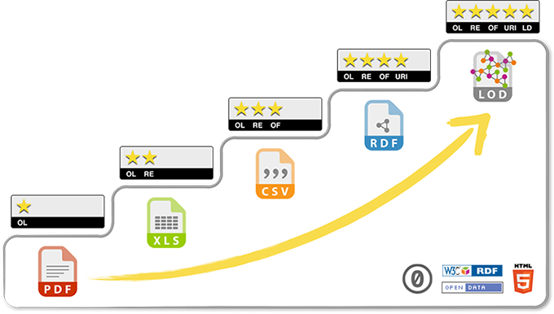
5 * Open Data
related to other data
identified by URI
non-proprietary format
in a structured format
Data on the web, open licence
Bioinformaticians
Biologists
Courtesy of Daniel Jacob
Progressing towards FAIR and Open Data requires a multidisciplinary cooperation :
Biologists
Bioinformaticians
Specialists of ontologies/semantics

Slide 13




Challenges for phenomics data
FAIR data
Findable
Persistent identifier (ex: DOI)
Rich Indexed Metadata
Data portal
Accessible
Open data / DMP
Data portal
Interoperable
Web API
Linked data
Web semantics
Data formats
Reusable
Metadata standards
Licence / Publication
Documentation
Findable
Distributed model: no central phenomic data archive but several repositories
Share among complementary repositories the same policy in terms of ID, metadata, …
Accessible
Complex life cycle; different types of data : complex DMP
Interoperable
Compatible standards and formats along the data life cycle
Issues in relation with big data
Reusable
Phenotype = Genotype x Environment x Cultural practice => differents silos of metadata definiton

Slide 14
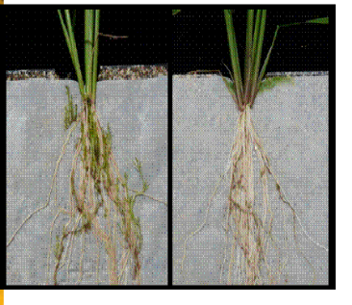
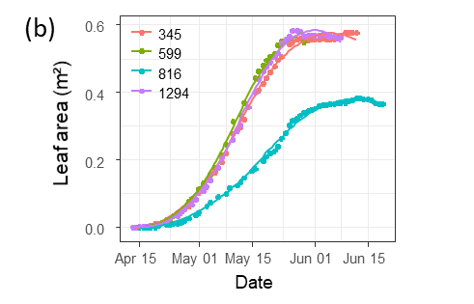
Phenotyping data life cycle
Raw data
Elaborated data
Soissons x high N
Charger x high N
Charger x low input
Soissons x high N
Charger x high N
Soissons x low input
Soissons x low input
Soissons x high N
Soissons x low input
Charger x low input
Charger x high N
Soissons x high N
Soissons x high N
Genotype | Treatment | N input | Date | Rep | Fusariose
Soissons | low input | 15,32253129 | 15/11/2011 | 1 | 5
Soissons | low input | 15,31430556 | 16/11/2011 | 2 | 7
Genotype | Treatment | Fusariose
Soissons | low input | 6

Slide 15
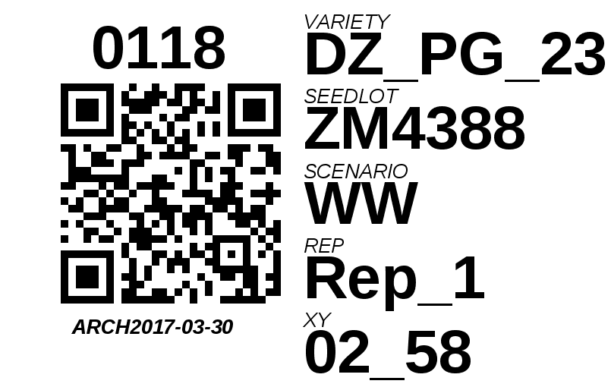
Object identification (URIs)
URIs (Uniform Resource Identifiers)
standardized, unique, unambiguous identification of objects
The object to identify depends very much on the data to be connected/linked between data sets: infrastructure, sensors, people, plant material, variables…

Slide 16
Semantics to link data and develop knowledge
Define concepts: plant, plot, phenotype, experiment, event
Define relations: plot contains plant
Based on common vocabularies and ontologies: Agrovoc, Crop Ontology, Extensible Observation Ontology (OBOE), …
Allows inferences and complex data queries
Study
Observation Unit
Factor
hasGenotype
Plant
Genotype
Treatment
contains
hasGenotype
Measure
hasGenotype
Plant
Genotype
Value
Time
contains
Ontology
isApplied
isApplied
isApplied
Plot
Treatments
Plot
Treatments

Slide 17
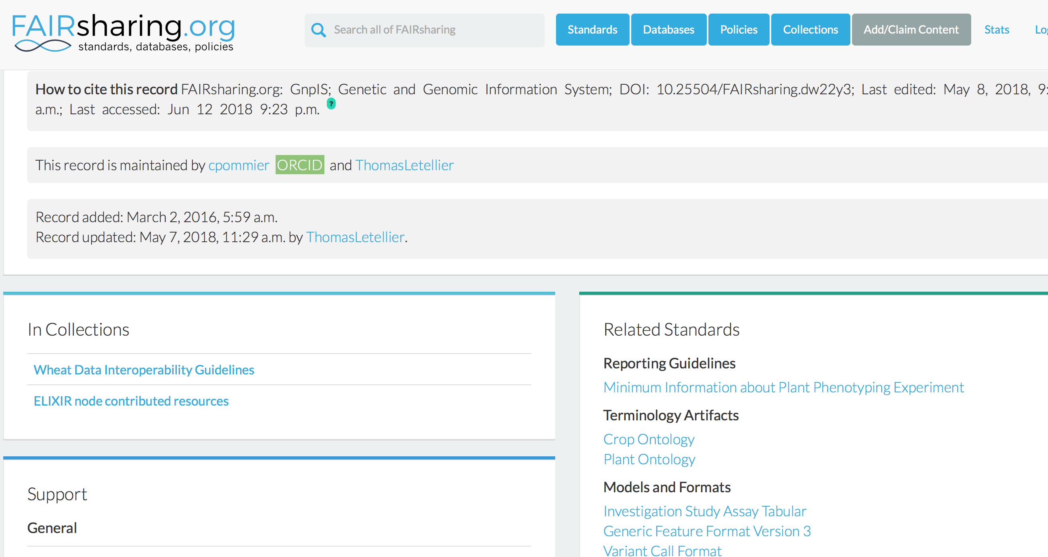
Sharing standards: standards registries

Slide 18
Networks

Slide 19







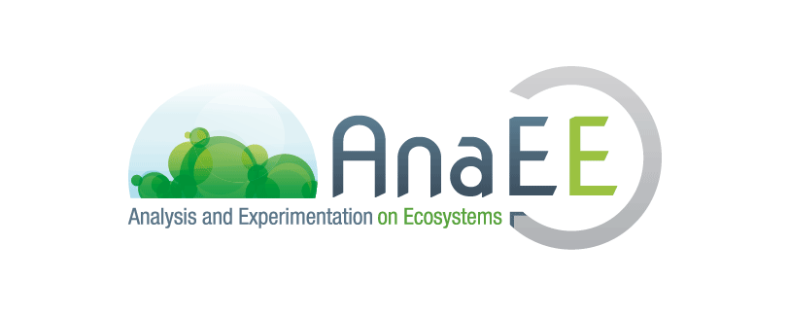




Interoperability in network
French Networks
European Networks
Global Networks
+
?
International data Standards
MCPD
Notes:
19

Slide 20

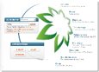



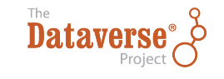


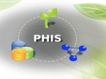
Data Publication, Standards, Portals
Identification
Ontologies
GnpIS
Ephesis
Web Services
Generic Data discovery
Infrastructure
Storage
Archive
Compute
Notes:
Maybe too much for intro ?

Slide 21
Conclusion

Slide 22
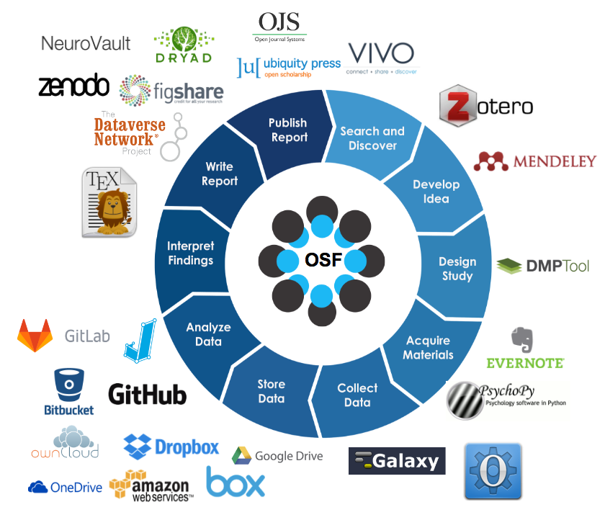
Remaining challenge: provide operational (international) environments facilitating data management all along its life cycle
From Rowan University, NJ, USA

Slide 23
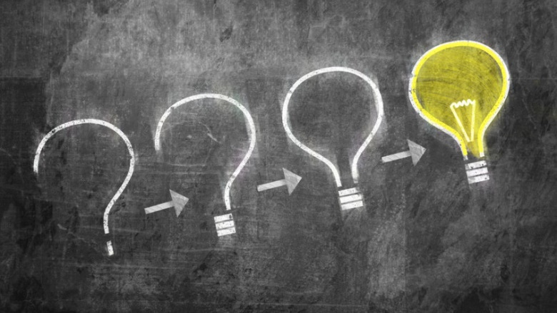

Slide 24
Phenotyping data life cycle
Data acquisition
Raw measures
Data cleaning
Platform IS (Emphasis, PHIS…)
Data computation
A new computation for each scientific question
One raw dataset => many computed datasets
Data publication
A publication by dataset
Platform IS: Raw data
FAIR Repositories: Computed data
Traceability & Reproducibility
Analysis documentation
Raw data long term conservation

Slide 25
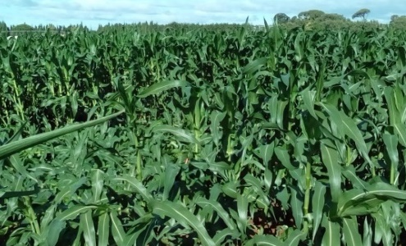
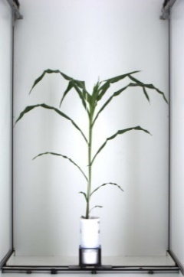

Annotation of events: plot and plant accidents
anno480
oa:hasTarget
Plot 97
Plot 98
plot97
dcterms:creator
dcterms:created
oa:bodyValue
"2017-06-29”
‘Plots lodged after the storm’
Romain
anno86
oa:hasTarget
plant795
dcterms:creator
dcterms:created
oa:bodyValue
"2017-05-15”
‘Fallen plant during imaging’
Llorenç
Events or follow the Web Annotation Data Model that allows assigning motivation and purpose attributes to annotations (e.g. oa:describing, oa:identifying, oa:linking, oa: replying, etc.). Dublin Core properties such as dcterms:created or dcterms:creator are also used.

